Slide 1
S24 SD2 Schaeffler Group
Camera Stamping Phase 2
Project Status Review PSR
2/15/2024
Authors: Joshua Ayers (CPE), Alexander Bussard (MET), Slade Garraghty (MEGR), Aiden Lamar (CPE), Steven Medrano (EEGR)
Mentor: Ms. Nan BouSaba
Industry supporter: Mr. Alex Perry
Notes:
Joshua + everyone introduction

Slide 2
Outline of Today’s Presentation
01
Introductory Slides
04
Electrical Systems
CDR Recap:
Objective
General Requirements
Defect Examples and Specifications
Following elements:
Schematic Diagram
Updated Wiring Diagram
Current system and prototypes
Wiring and mounting
02
Mechanics and Assembly
05
BOM Changes and Costs
Preliminary Design of Hinging Mechanism:
Acquisitions and Purchasing
Prototyping and subassemblies
Following elements:
Failure Mode & Error Analysis
Costs: Pie Chart
Reference: Bill of Material
03
Software and control
06
Closing Slides
Specifications for the following selections:
Circuit python, Pybotics
Electronics: MCU/HAT, Motor Drivers, Andon Light, & Keyence Camera
Following elements:
Conclusion
Timeline/Next Steps
References
Notes:
Steven

Slide 3
Objective
In order to bolster quality control early in Schaeffler’s needle bearing housing manufacturing, SG_STAMP2 will design a system to catch and analyze needle bearing housings on a belt. This system will use an AI camera to check for defects in components so that they are caught before significant value is added to the parts.
Notes:
Alex

Slide 4
Project Impact
Frugal part analysis systems like ours could make an impact in the following ways:
Primary component manufacturers will be able to spend less money and man hours on part recall or production back checks.
Part errors will be caught earlier and not result in as much wasted raw material.
The chances that an unsafe part is placed in a consumer’s automotive product will be reduced.
Notes:
Alex

Slide 5
General Requirements
Build a system that involves a precise defect analysis on bearing housings manufactured by Schaeffler.
Extraction of bearing housings
Scan for defects/Alert operator
Dispose/reinsert bearing housings
The process should be executed every couple mins.
Successful run every 5-10 mins. (Cleared or Defective)
[Project Scope]
Notes:
Steven

Slide 6
General Requirements Cntd.
Appropriate disposal of the bearing housings with operator being alerted of the part’s condition.
Obtain necessary hardware & software to produce a sustainable product.
Compatibility with varying part sizes.
[Project Scope]
Notes:
Steven

Slide 7
Specifications and Standards
ANSI B11.19: Safety Regarding Installation, Operation, and Maintenance
IEC 60204-1: Safety of Machinery including Electrical Equipment
IEEE 2755.1-2019: Taxonomy for Intelligent Process Automation Product Features and Functionality
IEEE P3110: Standard for Computer Vision (CV) - Technical Requirements for Algorithms Application Programming Interfaces (APIs) of Deep Learning Framework
Notes:
These are specific standards we have identified as relevant to or type of project, however Schaeffler has yet to provide us with any official standards they need us to use.

Slide 8
USB
RJ45
Circuit Python

Slide 9
Mechanics and Assembly
Notes:
Josh

Slide 10
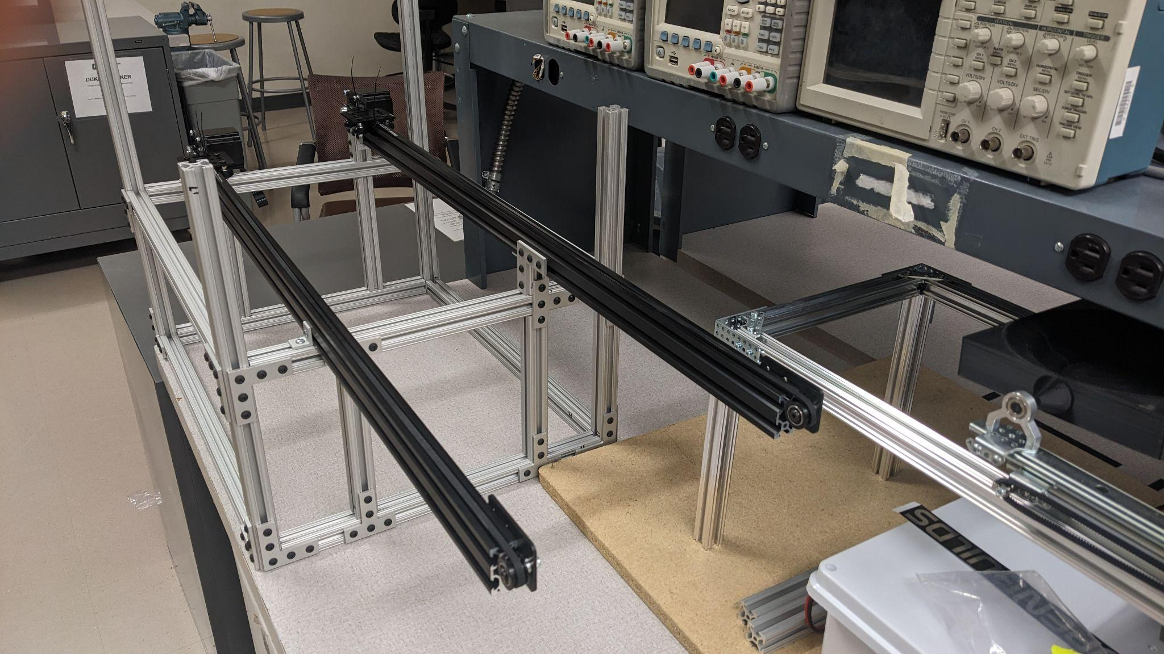
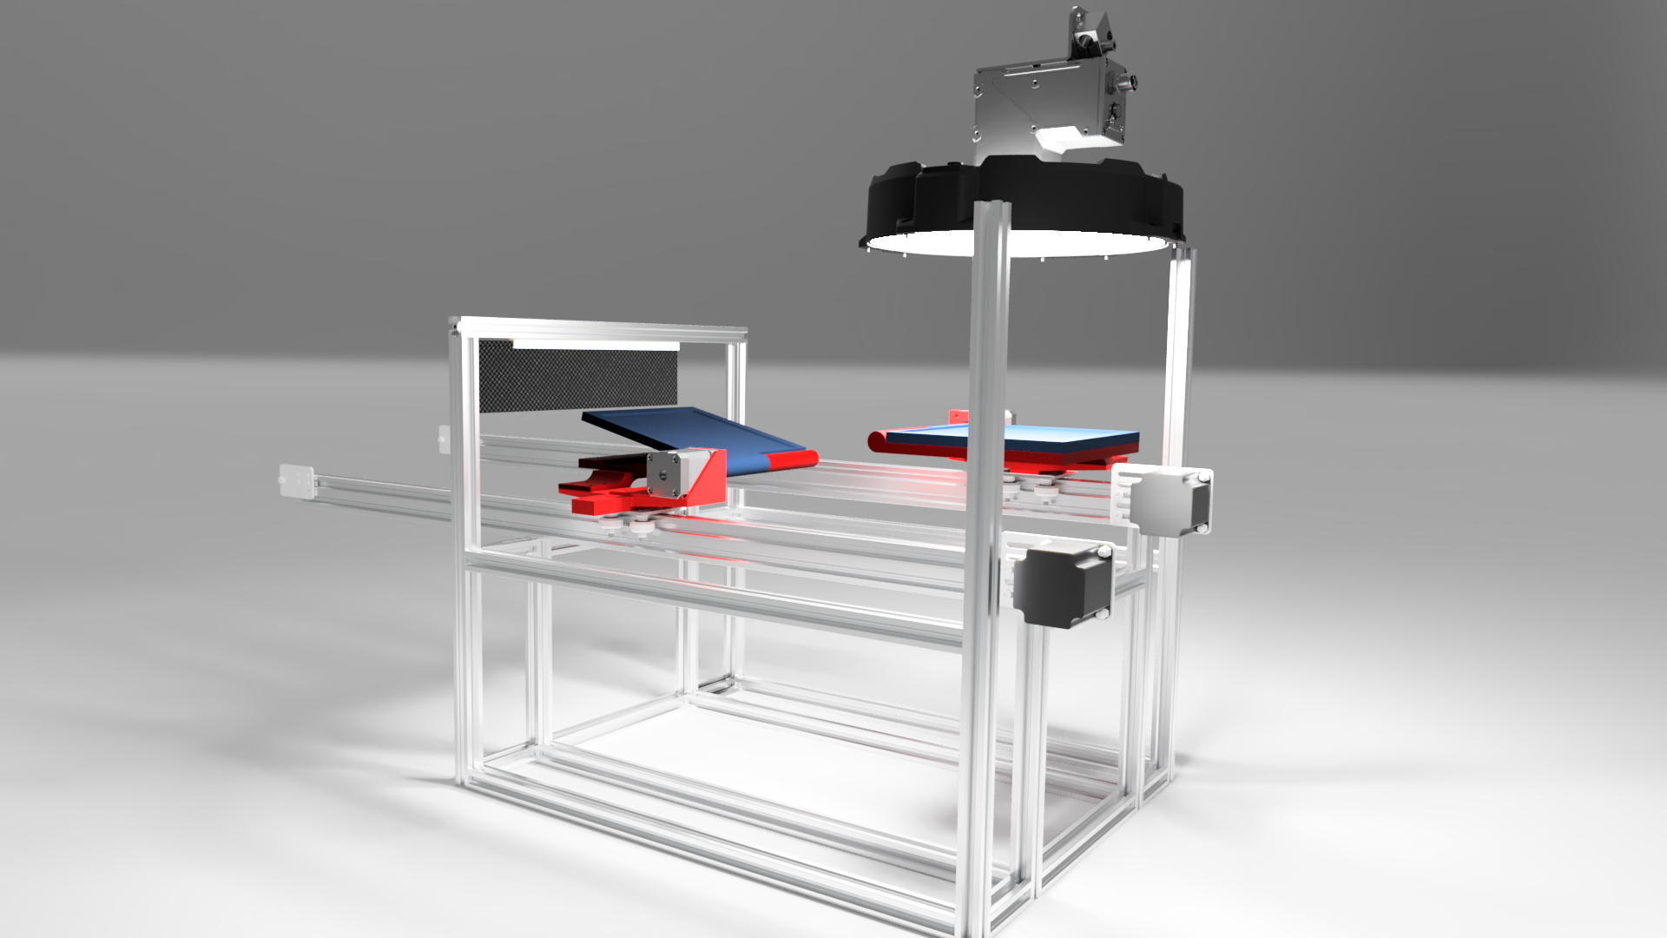
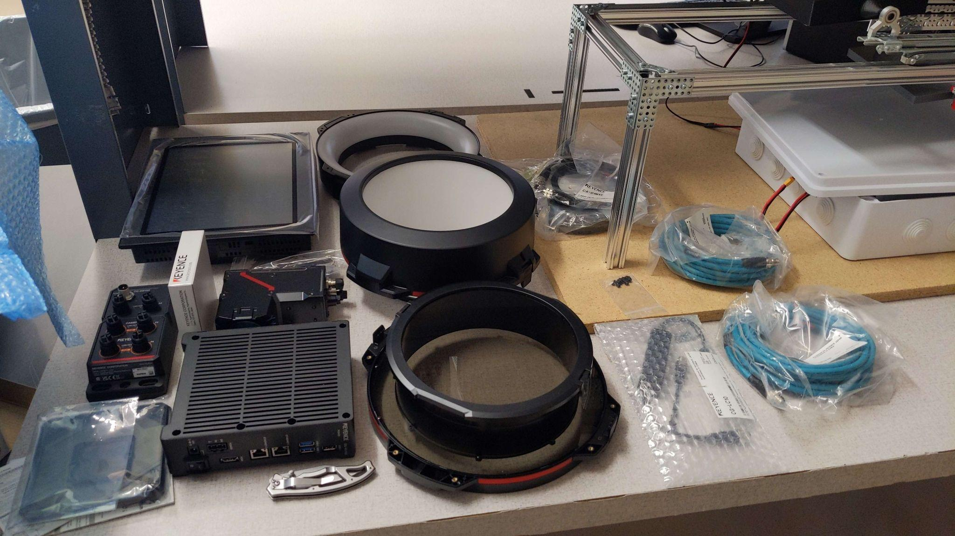
Prototype Assembly
[4]
Notes:
Aiden
-on conveor

Slide 11
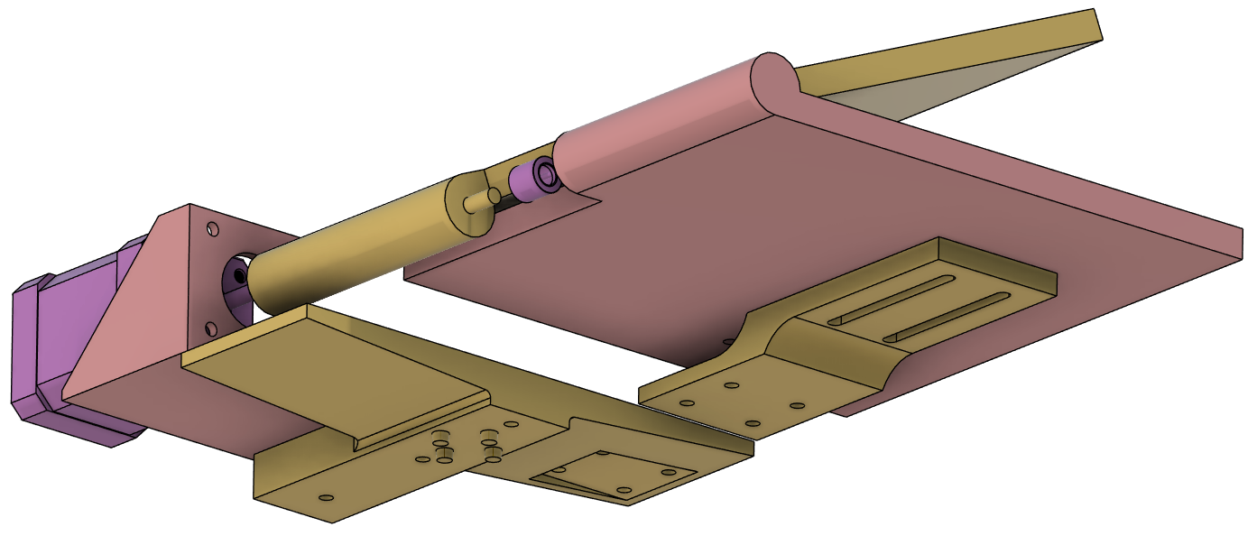
Hinging Mechanism Design
Needle Bearing
[5]
Nema 17 Stepper Motor
Top Plate (Rotating)
Bottom Plate (Stationary)
Resting Plate Bracket
Motor Mounting Bracket
Mounting Plate
Notes:
Aiden
-resting plat is sloted to allow adjustment of top plate on the shaft
-moiiunting plate has a hole on it’s far end to hold a counterweight to help move the center of gravity to sit above the actuator.

Slide 12
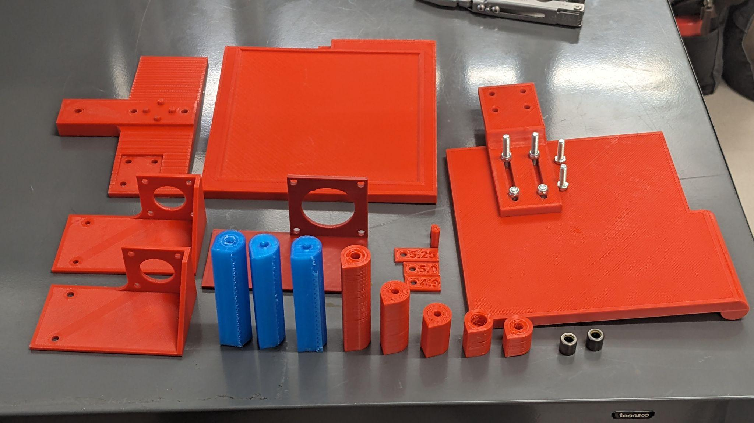
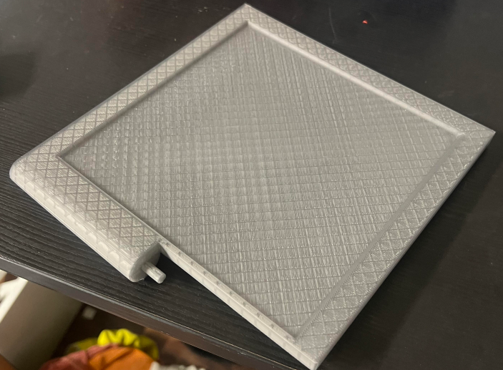
Hinging Mechanism Iteration
COM above Gantry Plate of V-Slot Actuator
Total Mass: 2.45 lbs.
Safety Factor of Motor: 4
Life of Motor: 1.15 years (24/7) or 400,000 cycles
Life of Hinging Plate: 1.5 years (24/7) or 380,000 cycles
[6]
Notes:
Slade

Slide 13
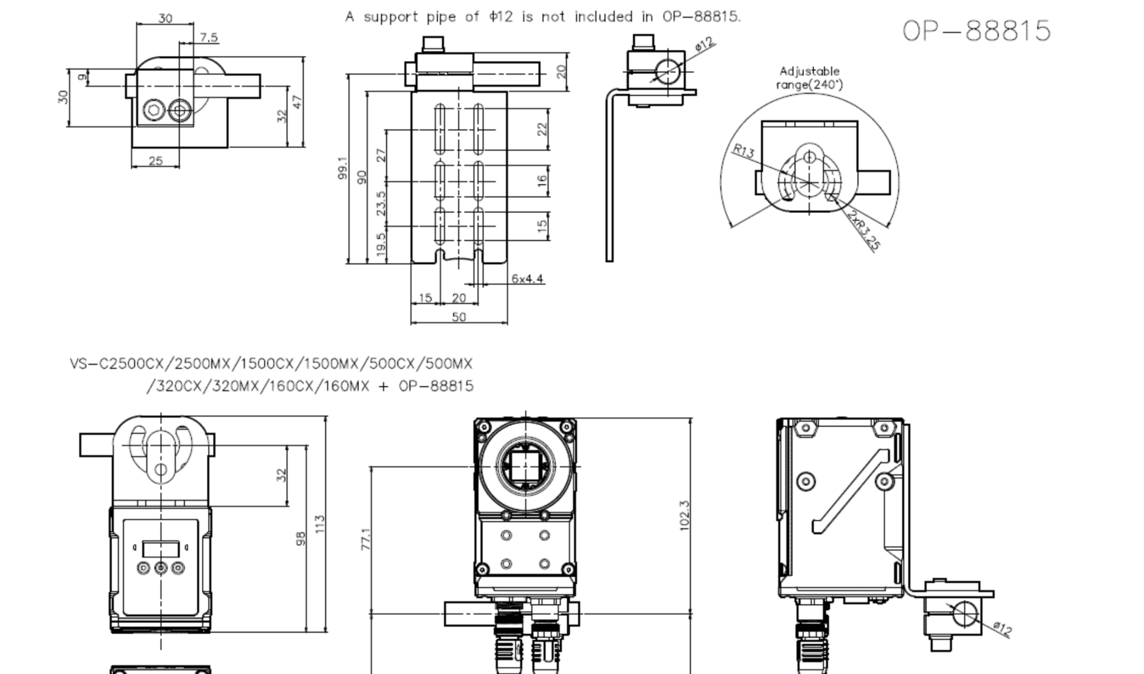
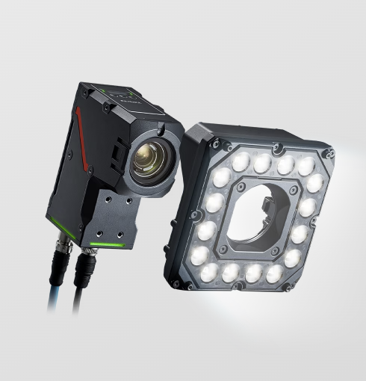
Camera Details
VS-L500MX Camera
Final Camera parts list
Keyence VS series AI Camera
Vision System Camera Cable
Lighting Controller-Vision System
LED Lighting for Vision System
Coding Camera
VS Creator
[13]
[14]
Notes:
Aiden
-multi lens aperture -LumiTrax lighting system -VS creator is the onboard software -final purchase is currently finalized and should go through by the end of the month

Slide 14
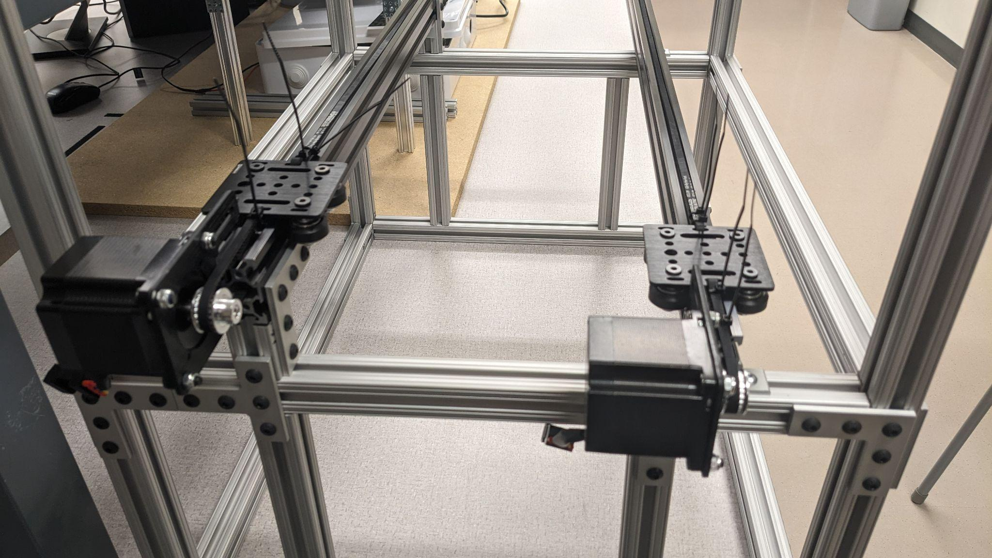
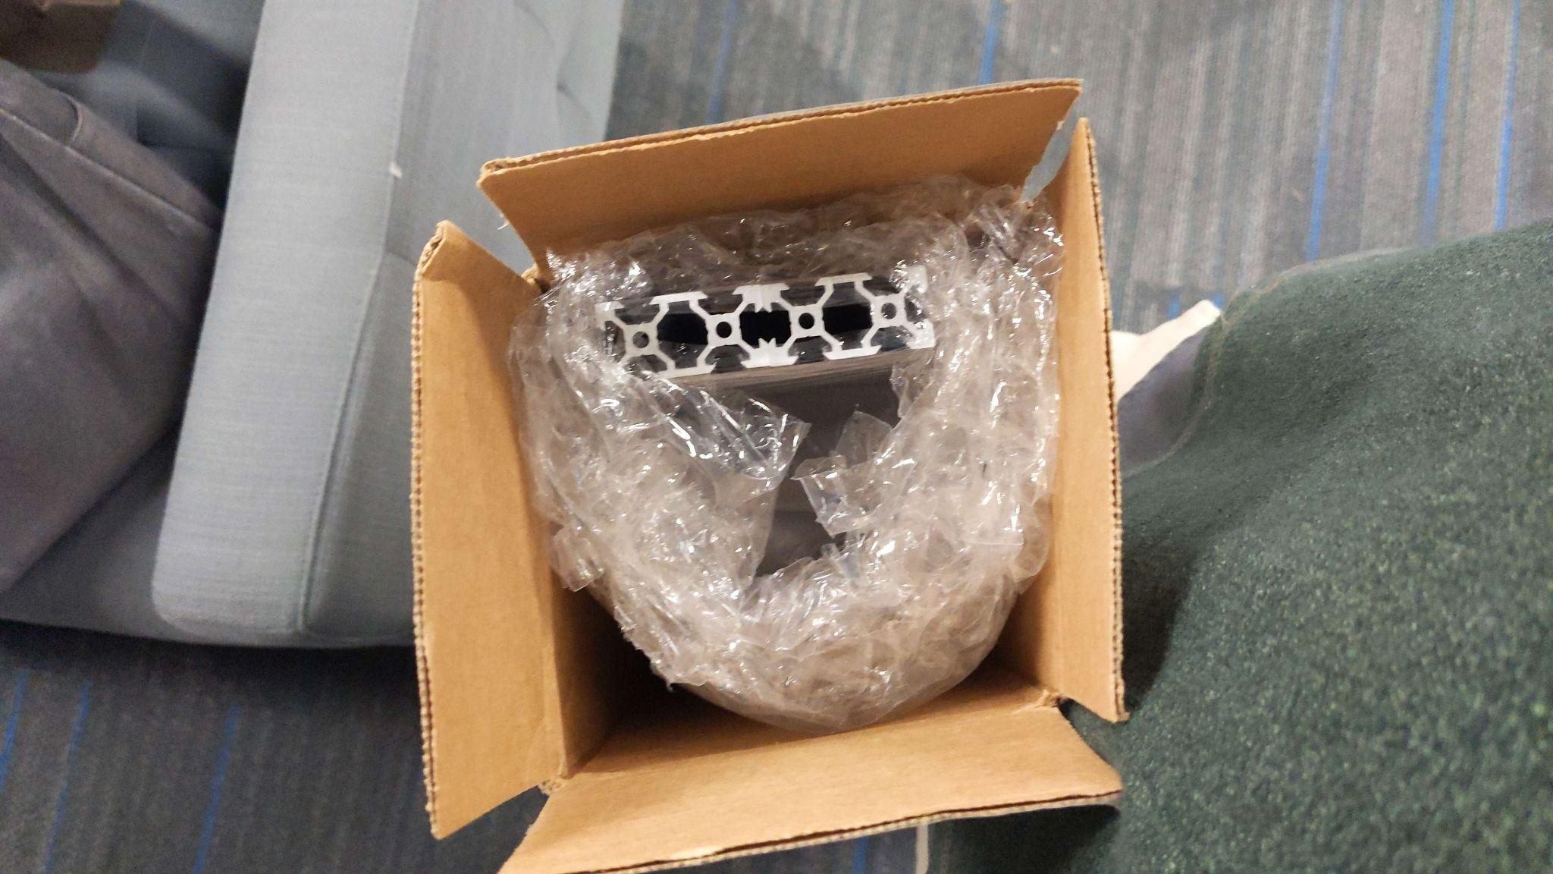
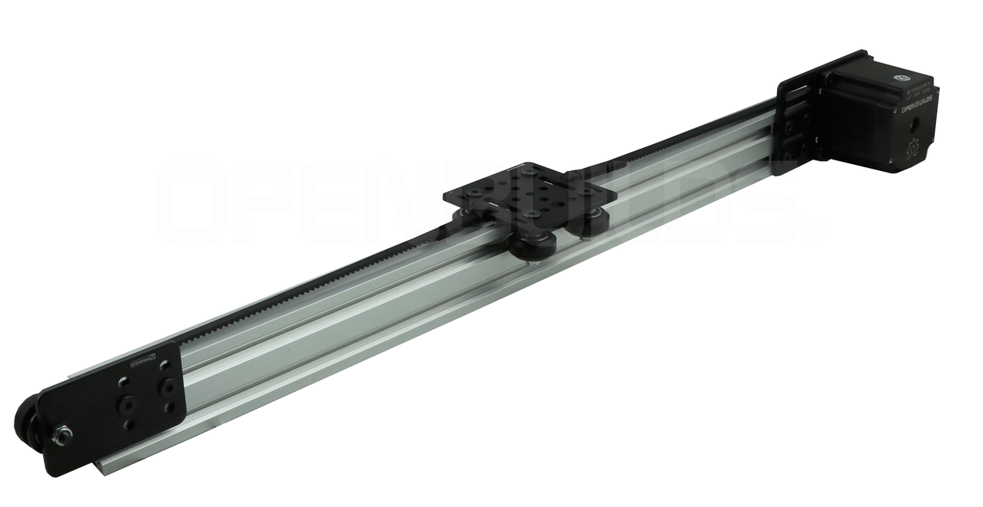
Linear actuator construction
As of 1/23/24 we were able to acquire and assemble the linear actuators within the next day.

Slide 15
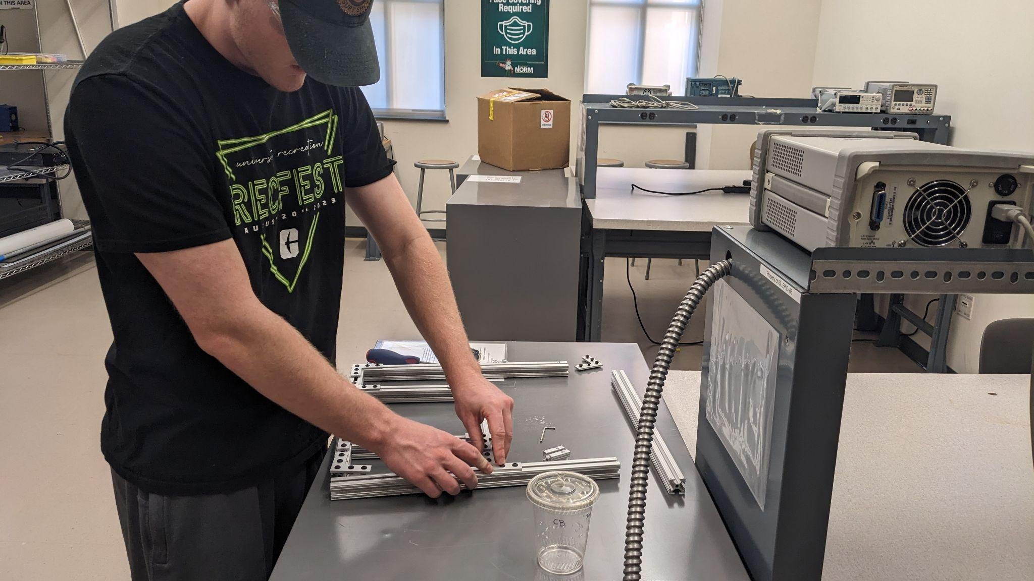
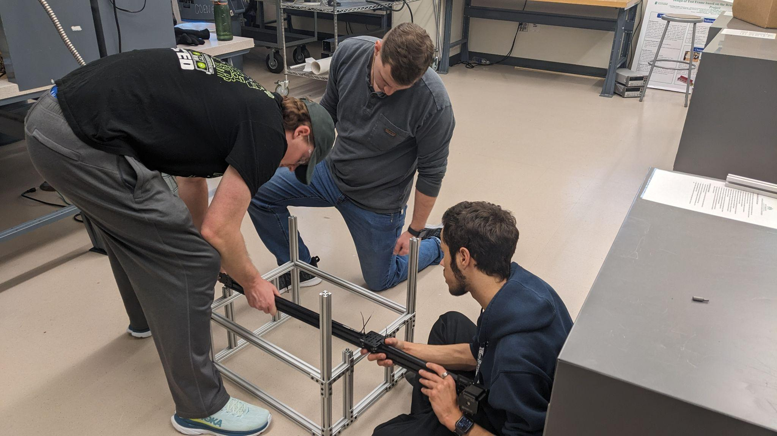
Base construction
80-20 Railing was acquired 1/25/24
Joinery for the 80-20 was acquired on 1/29/24
The 80-20 was measured, cut, and assembled on 1/31/24 to provide the base seen on the right

Slide 16
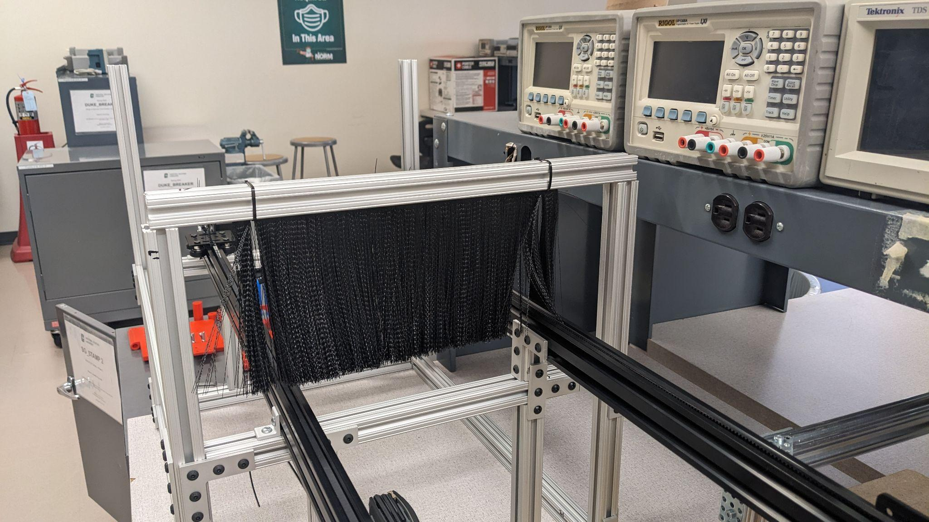
Brush
Debris brush was acquired and added after the base was coomplete

Slide 17
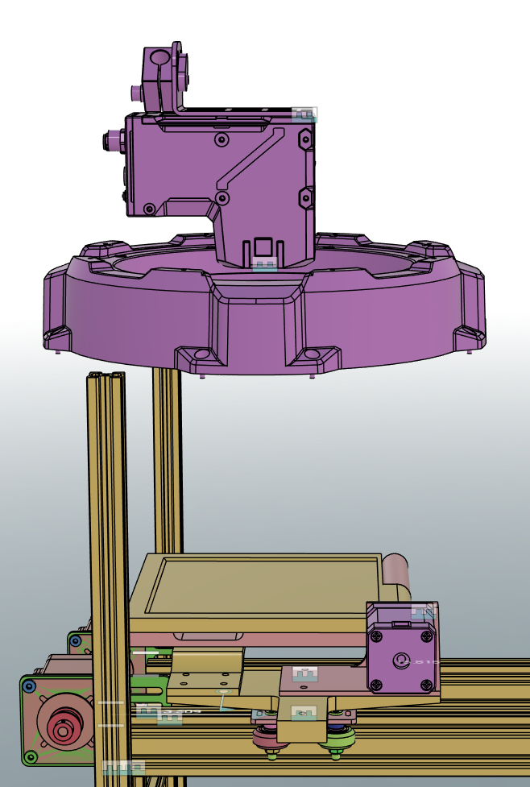
Camera Mounting
Camera must be 200mm above plate.
Camera and lighting fixture must be mounted separately.
Camera will be mounted to either 80x20 or a swivel mount, pending more information from Keyence.
[15]
Notes:
Aiden

Slide 18
COVER MEETING WITH AUDREY HERE

Slide 19
Software and control

Slide 20
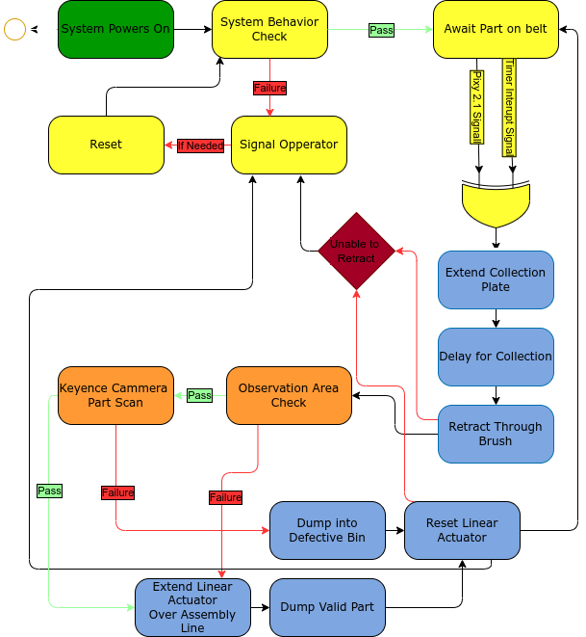
Programmatic Flowchart
[16]
We have produced a behavioral diagram
Analysis
Error Handling
Extension / Collection / Retraction
Notes:
Josh:

Slide 21

Circuit Python
Superset of Micropython
Designed to be extensible with standard Pip package manager
JIT compilation helps with device responsiveness and code dynamism

Slide 22

Raspbian
Standard debian Linux OS
Designed for Raspberry pie
Extensive documentation and support

Slide 23
Code and program architecture

Slide 24
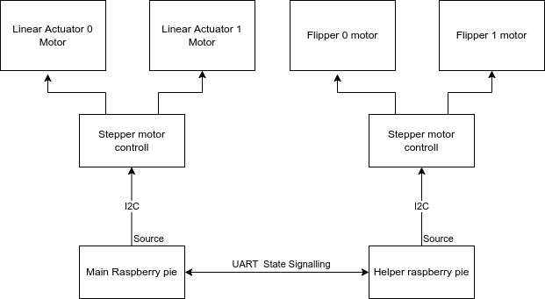
Main and Helper Raspberry pie
Given a slight change to the motor controller there has been a minor change in the control system given the available I2C channels on a raspberry pi and its delegation in the motor controller.

Slide 25
Electronic Components

Slide 26
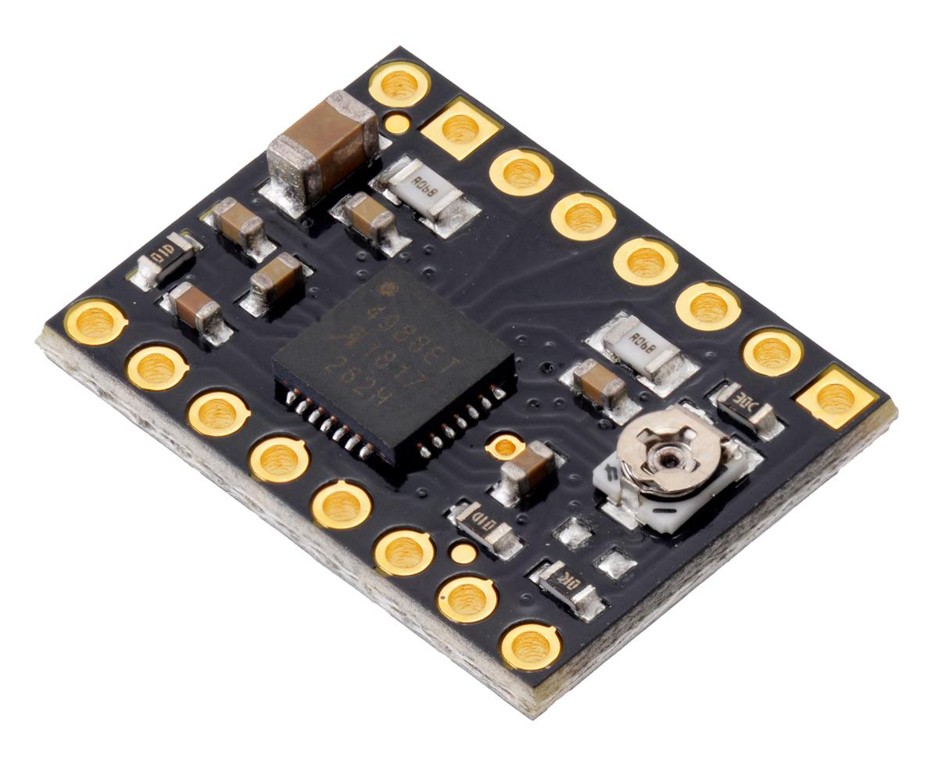
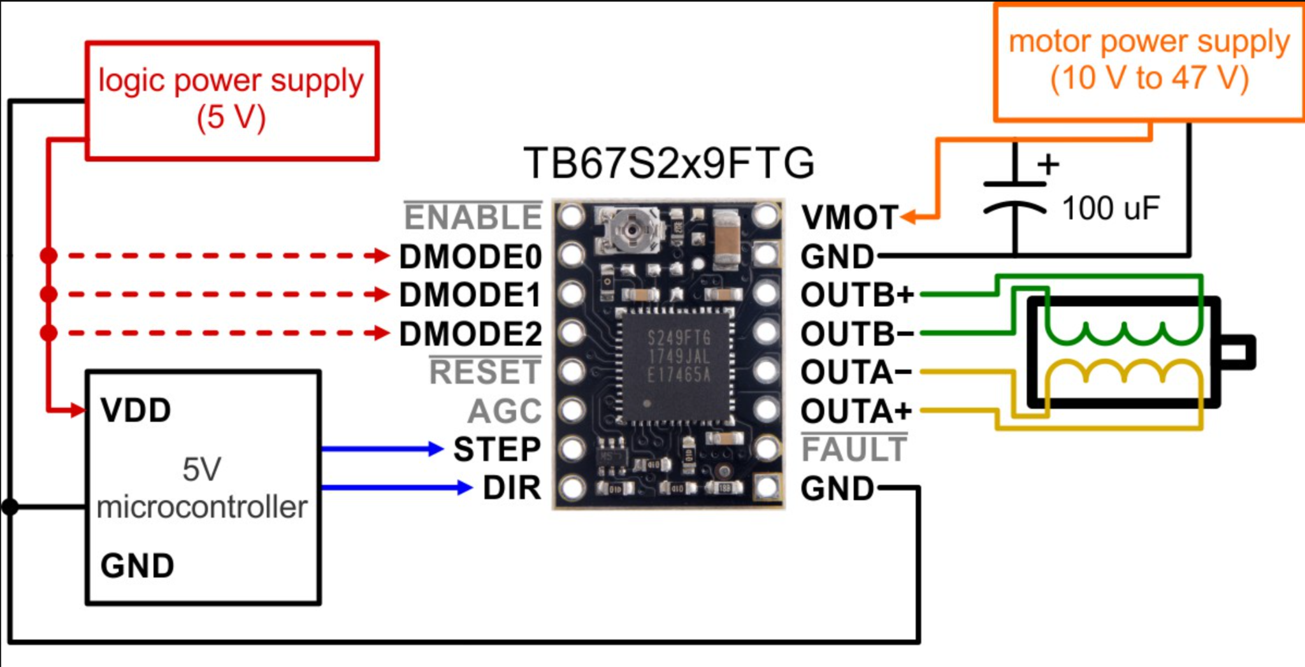
Control System: Motor Drivers
Model: Toshiba TB67S249FTG
Key features:
Simple step & bi-direction control
Can interface directly with 3.3V and 5V systems PWM and I2C interfaces.
Important Specs:
Motor supply voltage: 10V to 47V
Maximum current: 1.6A
[17]
[18]
Notes:
Steven

Slide 27
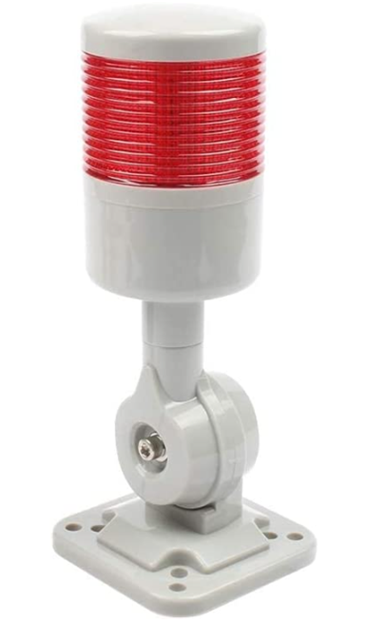
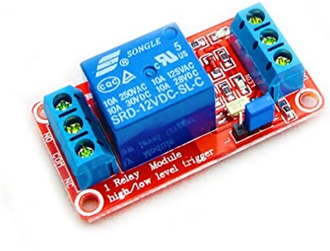
Control System: Andon
LUBAN Led Signal Light
One color
Has a buzzer
Receives signal from microcontroller through the HiLetgo Relay
Powered by 12V-24V DC
[20]
HiLetgo 12V Relay Module
12V DC
30V max
10A max
[19]
Notes:
Steven

Slide 28
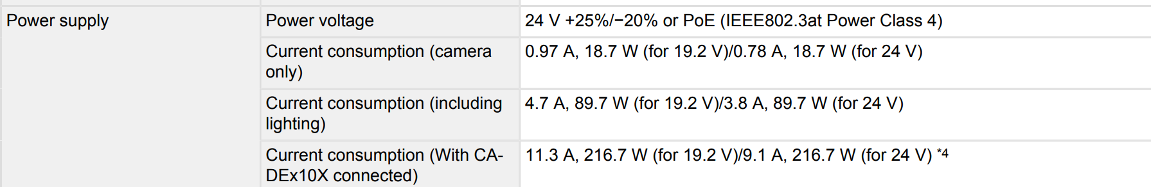
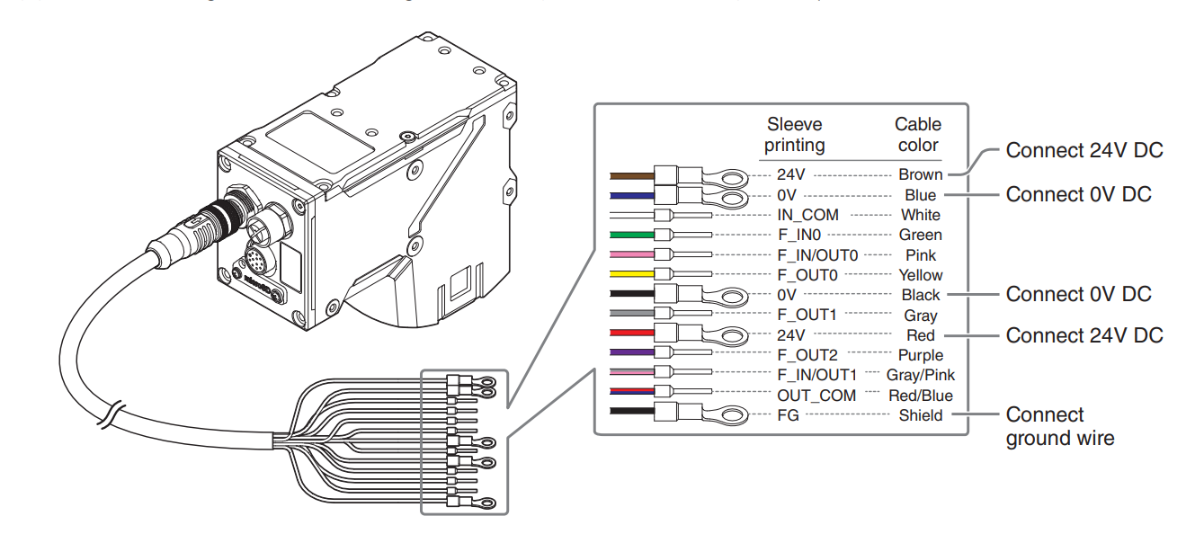
VS-L500MX: Power Specs
[21]
Notes:
Steven

Slide 29
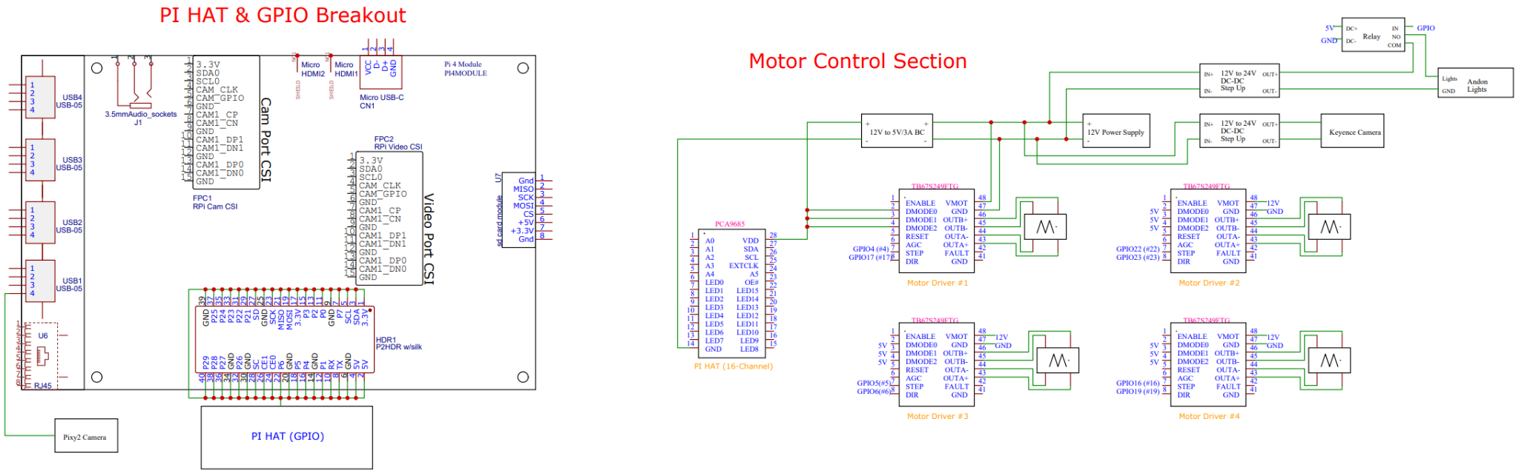
Wiring Diagram
[23]
Notes:
Josh

Slide 30
Budget and BOM

Slide 31
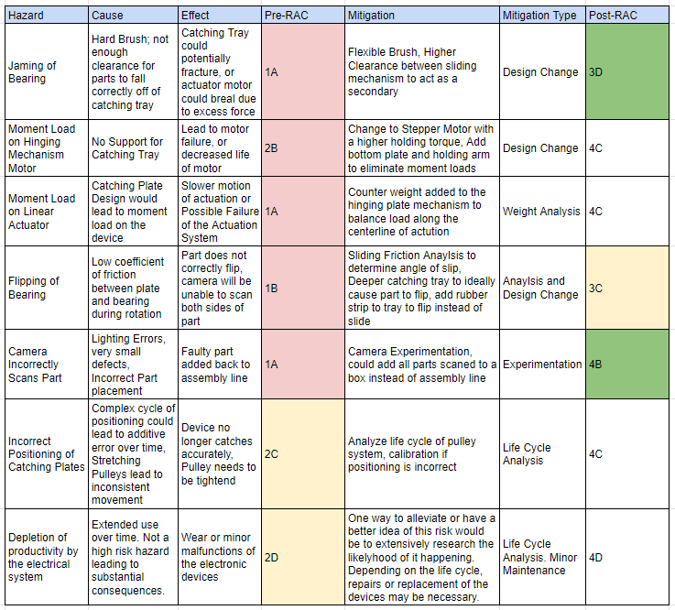
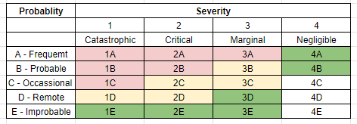
Failure Mode & Effect Analysis
Severity Level:
Color Key
Red: High Risk
Yellow: Possible Risk
Green: Low Risk
White: Negligible/ No Risk
Pre-RAC: Before Mitigation
Post-RAC: After Mitigation
Notes:
Slade

Slide 32
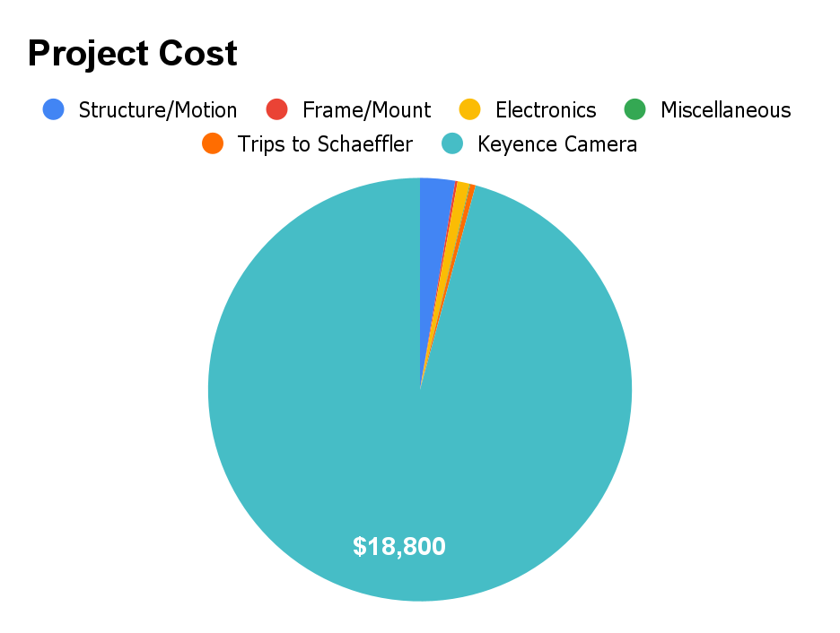
Costs
Section Breakdown
Total Cost: $745.00
Structure/Motion: Purchases which go into the overall structure and motion of the system.
Frame/Mount: Purchases necessary for the camera mount.
Electronics: Purchases of anything electronic.
Miscellaneous: Sweeping Brush
[24]
Notes:
Josh

Slide 33
Conclusions
Our mechanical design is almost complete with the base and linear actuators installed and rapid prototyping of the flipping mechanism
Once we acquire camera, mount design will be finalized
Notes:
Alex

Slide 34
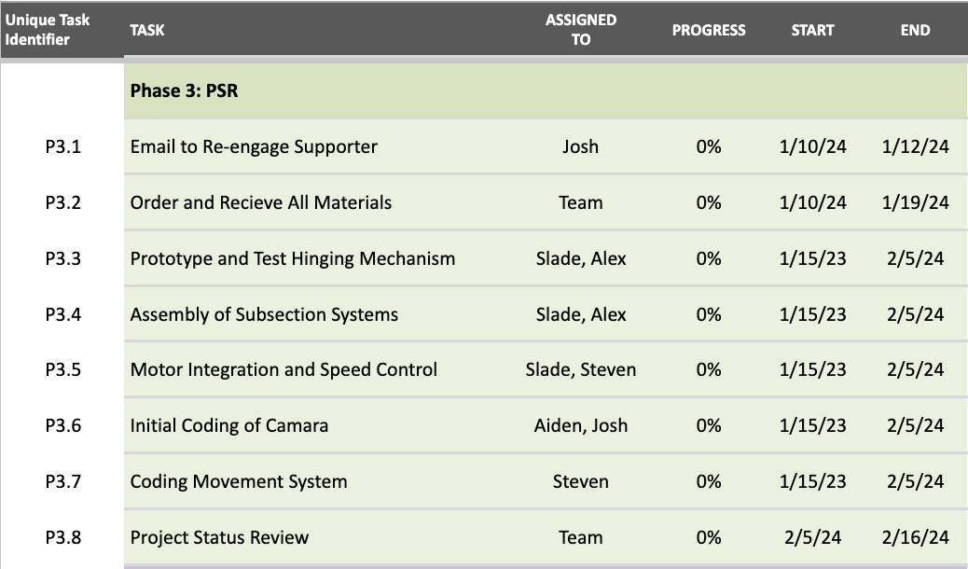
Change This Slide
Remaining Tasks and Dates:
Next Semester Initial Dates:
Finalize Design from PDR Feedback by 12/1
Finalize all Project Documents by 12/1
Begin Purchasing and 3D Printing Parts through 12/7
Senior Design 1 Expo 12/8 from 9am - 3pm
Notes:
Josh

Slide 35
Questions & Suggestions
Notes:
Josh:
Now we will open up for Q&A and suggestions.

Slide 36
References
ISL. Schaeffler Project Scope: Stamping AI Camera. Project Overview Documentation. ISL, 2023 (accessed September 2023).
Mercer, Cameron, & Vujicic, Borna, & Hagler, Kevin, & Pruitt, Blake, & Taraz Ali, & Medina, Alan. Final Design Structure. Physical Prototype. SG_STAMP1, 2023 (accessed September 2023).
Mannion, Audrey. Schaeffler Bearing Inspection: Vision Proposal Report. Presentation Slides. KEYENCE CORPORATION OF AMERICA, 2023 (accessed September 2023).
Schaeffler Bearing Inspection: Vision Proposal meeting. Presentation pamphlet. KEYENCE CORPORATION OF AMERICA, 2023 (accessed October 2023).
Pixycam, pixycam.com (accessed September 2023).
In-Position Technologies LLC, dobot.com, (accessed October 2023).
STMicroelectronics LLC, st.com (accessed October 2023).
Digikey.com (accessed September 2023).
OpenBuilds Part Store, openbuildspartstore.com (accessed October 2023).
McMaster-Carr, mcmaster.com (accessed November 2023).

Slide 37
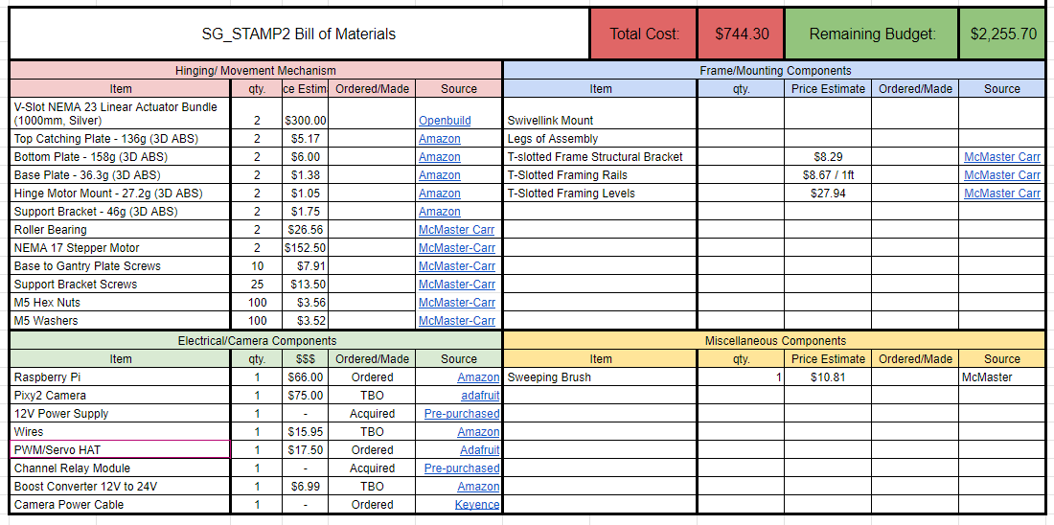
Bill of Materials

